Slide 1
WICCI ANTI – DOMESTIC ABUSE HARYANA STATE COUNCIL
WOMEN´S INDIAN CHAMBER OF COMMERCE AND INDUSTRY
www.wicci.in

Slide 2
Council Vision &Mission
The Haryana State Council aims at making Anti-Domestic Abuse Council for agenda to educate people in prohibiting abuse and harassment of domestic relationships and to awaken them about the rights and the duties under the laws prevailing in the country, for the protection of woman from domestic abuse.
Followed by the helpline and free litigation, we circulate amongst people so that the stress calls and help callouts can be handled.
The Council will also work towards providing free legal advice and legal aid to the women in need and victim of domestic abuse.

Slide 3
Welcoming
Council Members to
WICCI
President, Vice President
and 20+ Nominated Council Members

Slide 4
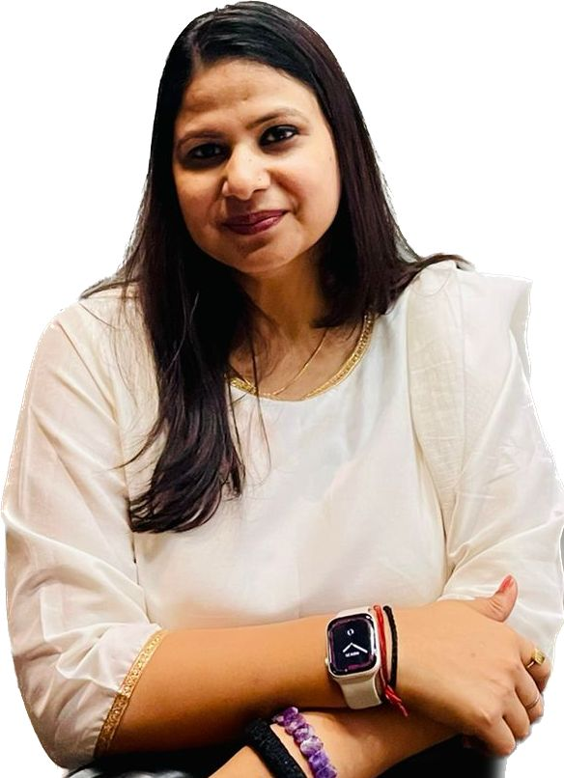
Adv. MEENAKSHI YADAV
PRESIDENT, Anti-Domestic Abuse Council OF WICCI
Legal advisor, Advocate and social worker, providing legal services related to Matrimonial Disputes/Cases, Sexual harassment of women at workplace (Prevention, Prohibition & Redressal) Act, 2013,Industrial/Labour Laws, Civil and Criminal related issues and fighting against Domestic Abuse matters at the pan India level.
Philanthropist & founder of NGO ‘Yashashish Foundation’, charitable Trust working for Educating, Enlightening and Empowering. Guest faculty at CDTI (Central Detective Training Institute) Jaipur under BPRD Ministry of Home Affairs. And external member if IC in 55+ organizations.
Email – meenakshi1yadav@gmail.com

Slide 5
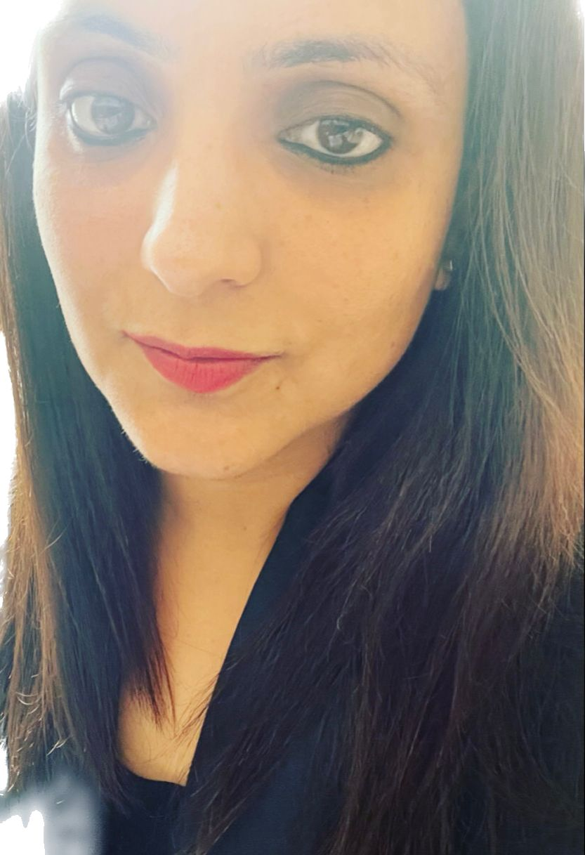
Adv. SHAILAZA KOTOCH Vice-President, Anti-Domestic Abuse Council OF WICCI
Practised at the Supreme Court for 3 years and deals with matrimonial cases, she assisted in a high-profile case of Laxman Bangroo & POSH Consultant giving training at pan India level in corporate sector.
Panellist at various webinars and seminars given for legal enlightenment & Awareness.
Email – shaliza.sagi@gmail.com

Slide 6
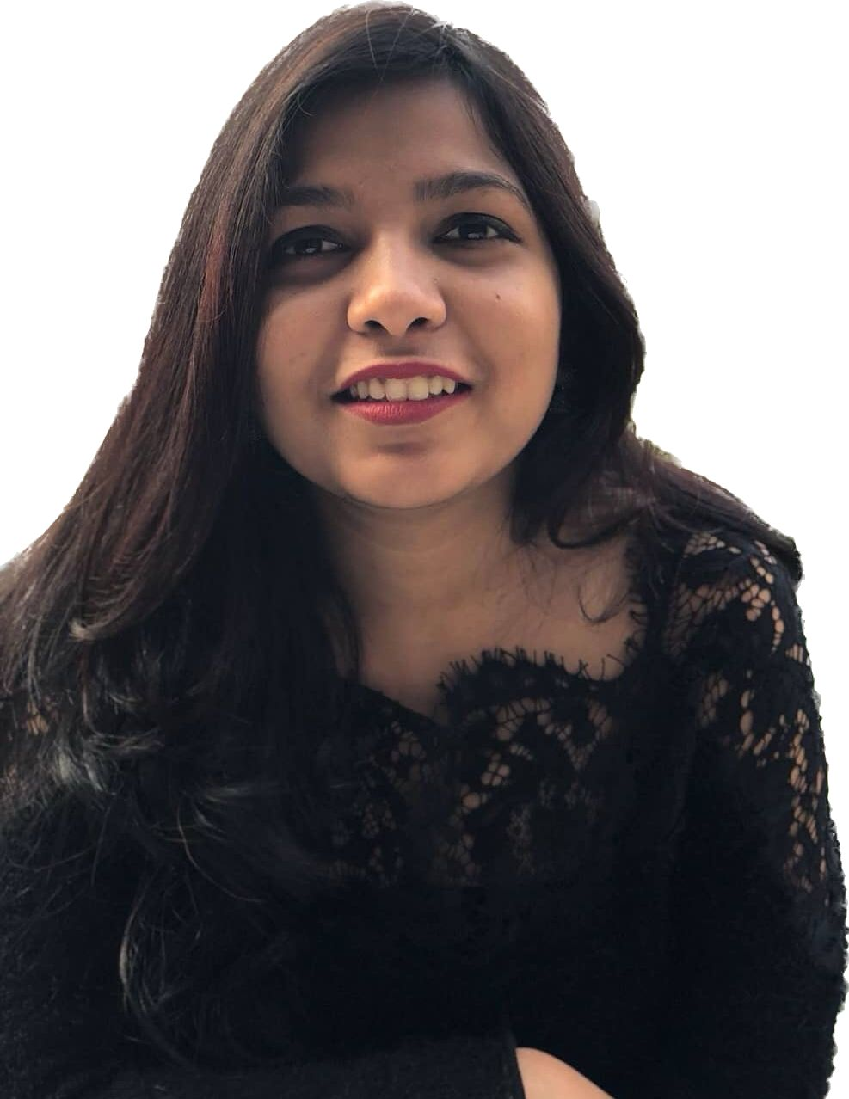
Adv. GAYEKA JAIN
COUNCIL MEMBER, Anti-Domestic Abuse Council OF WICCI
Corporate Legal Awaken advisor specialist in RERA and in addition to POSH Consultant & handling Compliance.
Another layer of success counted in terms of Contract Drafting & Negotiation Expert especially in Mercantile Law related to cloud software agreement, Master Service Agreement and including other corporate agreement. In a nutshell, actively participating in social causes and currently associated with M/s. Meenakshi & Associates.
Email – gayekajain10@gmail.com

Slide 7
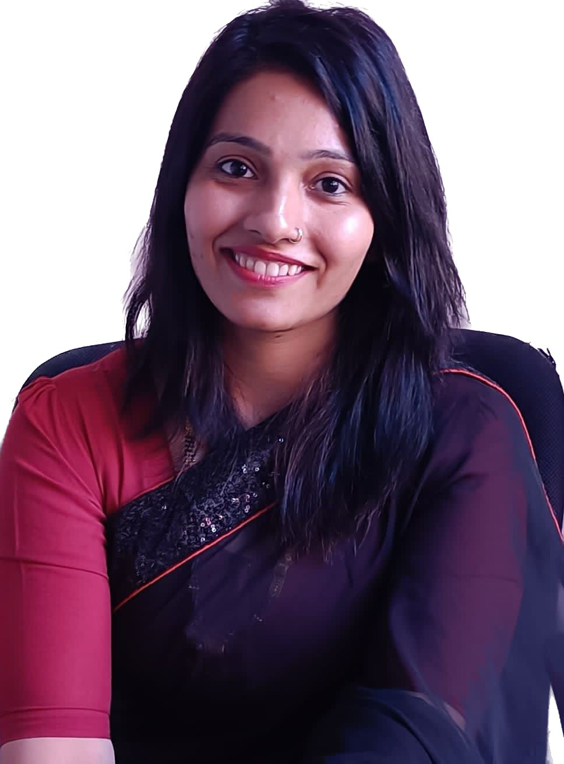
ANSHUL YADAV
COUNCIL MEMBER, Anti-Domestic Abuse Council OF WICCI
Acquired academic skills by doing MBA in HR & Marketing from the most renowned institution ICFAI National College Alwar.
Currently is handling position of Administrative Manager with R-tech group Corporate.
Email - - anshul.yadav59@gmail.com

Slide 8
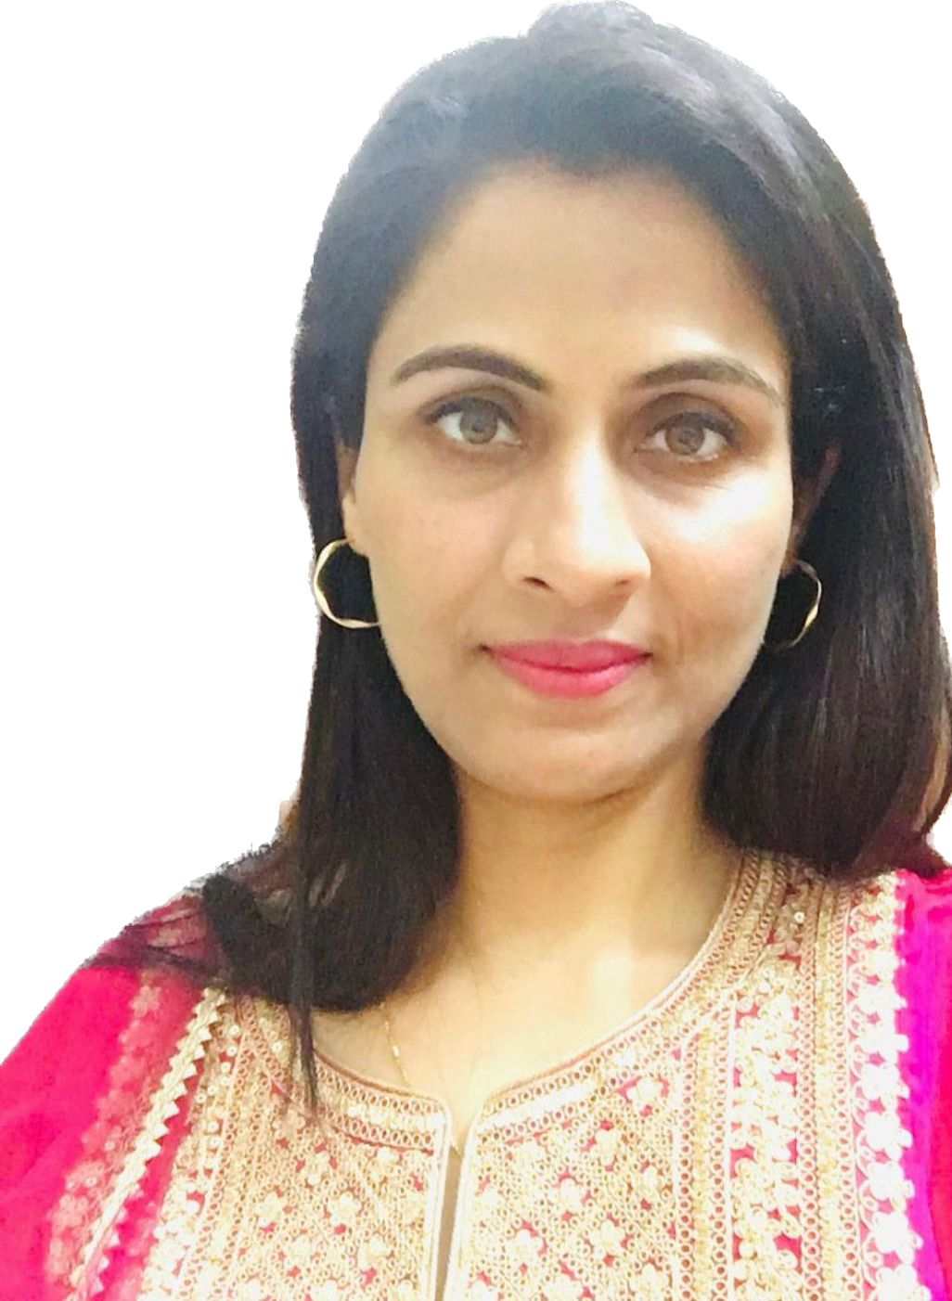
Dr PRIYANKA YADAV
COUNCIL MEMBER, Anti-Domestic Abuse Council OF WICCI
Graduated in Bachelor of Dental Surgery from Himachal Institute of dental Sciences. In addition to enhance the skills, completed Diploma in hospital management from Madurai Kamraj University. Worked in ECHS( ministry of defence) as Dental Officer and attaining 8+ yrs. of work experience.
Currently, owning a Dental Clinic in Alwar and serving best interest by giving free medical aid to needed ones.
Email - priyankayadav.feb@gmail.com

Slide 9
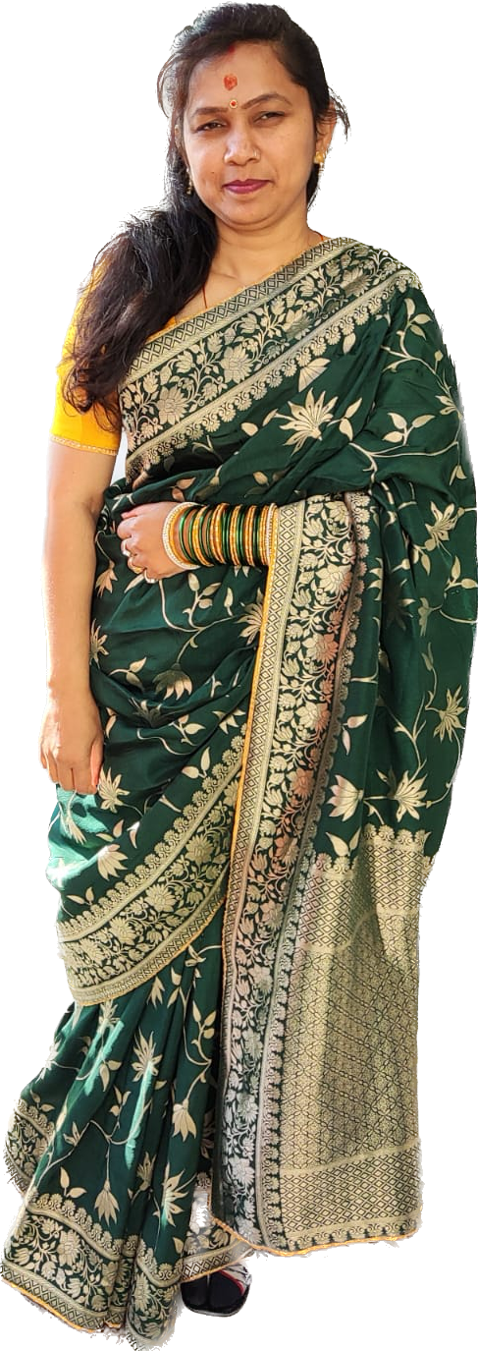
ASHU SABARWAL
COUNCIL MEMBER, Anti-Domestic Abuse Council OF WICCI
Acquired academic qualification in MA (Sociology) and on the belief of sustainable development and ancient practises to immune diseases are best to combat against diseases on faith of that pursued Diploma in Ayurvedic pharmacist.
A homemaker, mother breaking the celling of glass by actively raising hands against the all forms of abuse in the society and not believing in staying with domestic boundary.
Email - manishkumar14aug@gmail.com

Slide 10
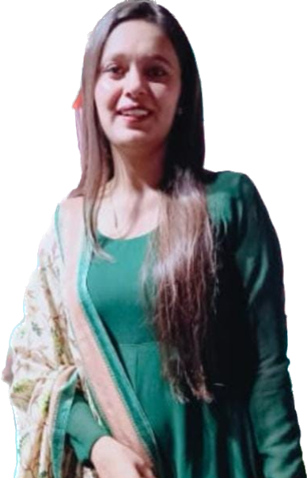
PINKI BHARDWAJ
COUNCIL MEMBER, Anti-Domestic Abuse Council OF WICCI
Taxation Consultant & Advisor of years experience handling MNC Co. and other Corporate offices by filling annual return, audit and legal compliance in the taxation matter.
At present, she is associated with Advocate Yogender Garg at Gurugram District Court.
Email - bhardwajpihu90@gmail.com

Slide 11
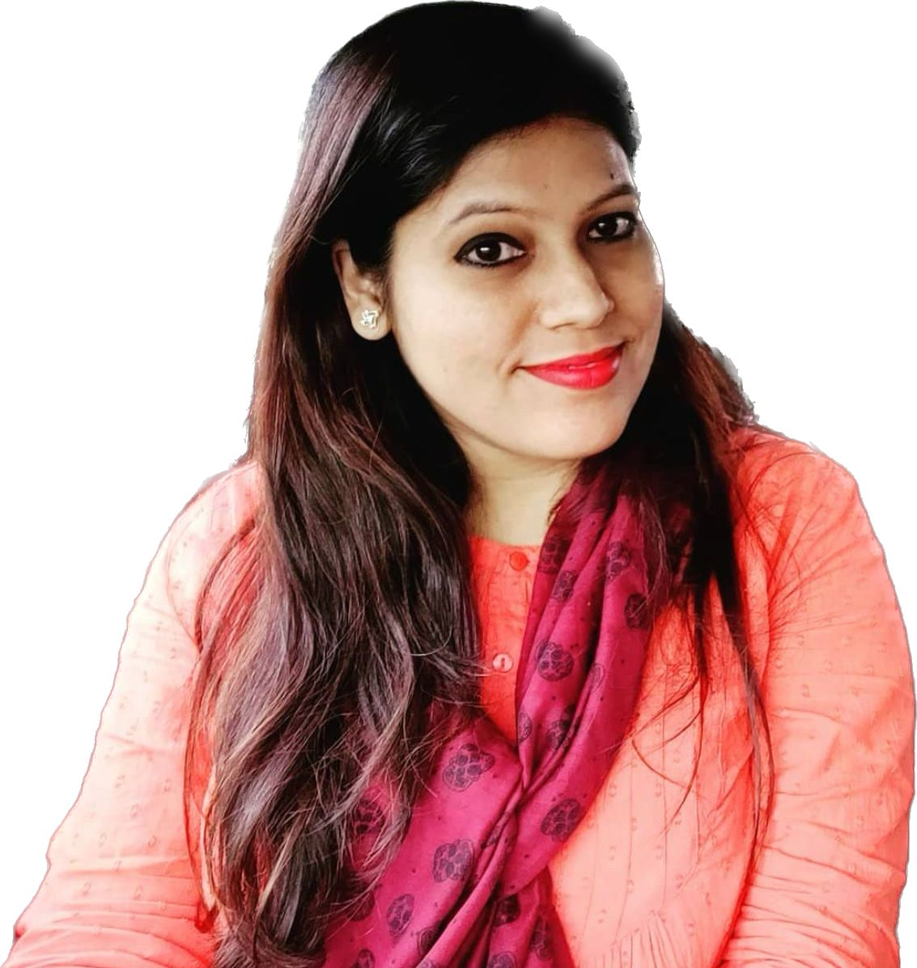
MAMTA SINGH COUNCIL MEMBER, Anti-Domestic Abuse Council OF WICCI
Legal Solicitor & Advocate, practiced 10 months in Session Court Agra.
An potential Judicial aspirant preparing for judiciary exams and at the same time working as Legal Advisor & Researcher in Yashashish Foundation.
Email - absolute.mamta@gmail.com

Slide 12
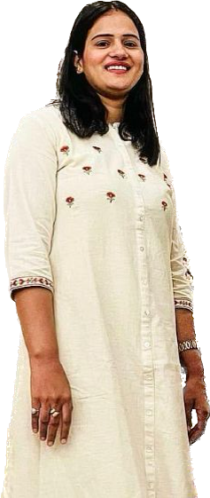
RENU BHANWALA
COUNCIL MEMBER, Anti-Domestic Abuse Council OF WICCI
Acquired graduation in Bachelor of physiotherapy and Masters in Cardio Pulmonary.
Holding 2 years experience at DMC hospital Sirsa, as a Physiotherapist in healthcare institute.
Providing free medical aid & sanitization and making aware about intimate hygiene which is an indispensable part of woman to combat against the chronic diseases spreading such practices at the mass level to unaware woman of society.
Email - - renurenu61937@gmail.com

Slide 13
Adv. ARPITA SHARMA COUNCIL MEMBER, Anti-Domestic Abuse Council OF WICCI
Graduation in Law from Northcap University Gurgaon an coveted institution of India.
Worked in Jurisperitus law office and presently aspiring lawyer, preparing for judiciary to contribute livelihood by following the policy of fair and just equitable serving the society and giving justice to the law system.
Email - - arpusharma2109@gmail.com

Slide 14
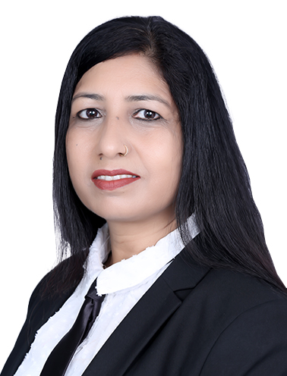
MANJU HATGAONKAR
COUNCIL MEMBER, Anti-Domestic Abuse Council OF WICCI
Attained 15+ years of experience as a grassroots worker, trainer and leader in diverse fields like Human resources, Sales, consultancy, and Insurance. With a strong educational background consisting of a Bachelor of Arts Degree from Gargi College, Delhi University followed by Masters in Sociology. In addition gathered knowledge in the legal field by pursuing law and work for the upliftment of socially underprivileged women and children.
Email - manjuhats@gmail.com

Slide 15
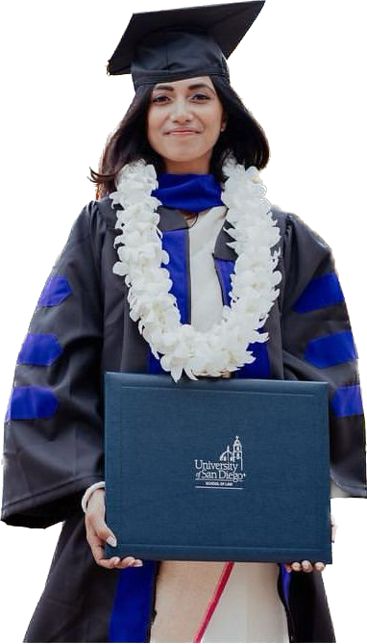
PUJA SARKAR
COUNCIL MEMBER, Anti-Domestic Abuse Council OF WICCI
An advocate surrounded by the International boundary acquired LL.M. (Comparative Laws) from the University of San Diego, California USA. In addition to working as Law clerk and handling pro-bono cases in California.
Past Background, she worked on Statutory Compliance Audit & Leal Risk Assessments and practiced in the Supreme Court, Delhi High Court, and other Courts/tribunals in Delhi in service law, labour law and medical malpractice/ negligence, and laws governing education in the country.
Email - pujasarkar.lawyer@gmail.com

Slide 16
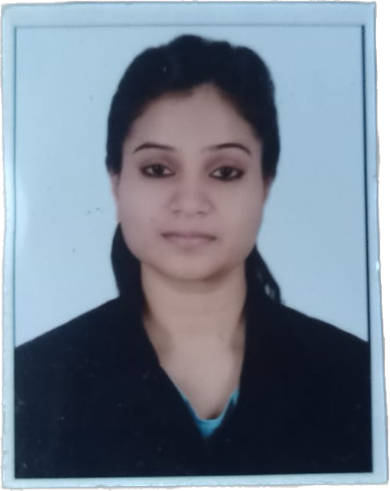
PRITI KUMAR COUNCIL MEMBER, Anti-Domestic Abuse Council OF WICCI
Chartered with law graduate from an coveted institution, and MBA (HR) from Symbiosis Centre for Management Studies, Pune. Thereafter she tagged along with Advocate Manish Mohan, Delhi High Court. She has an experience in the corporate sector working with Thomson Reuters and CPA Global, Noida. Presently, Legal Compliance & Manager with Yashashish Foundation and actively participate in different Social Service activities.
Email - pritikumar31@gmail.com

Slide 17
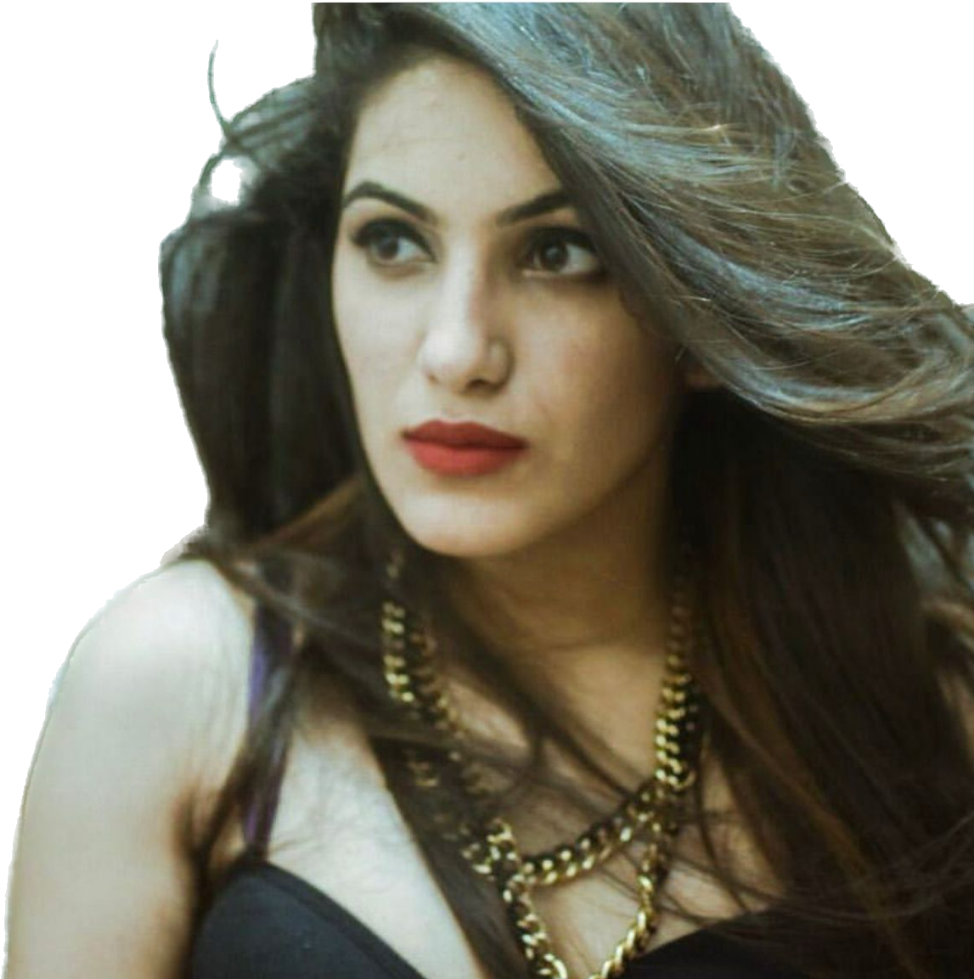
AIESHANI KATOCH
COUNCIL MEMBER, Anti-Domestic Abuse Council OF WICCI
Lecturer specialized in English Language and a professional tutor. In addition to, ILETS Coach to prepare upcoming generation in order to gain education at global level, and Foreign Overseas Councillor for selecting the top colleges and educational institutions at global village.
Email - Aishani.katoch7@gmail.com

Slide 18
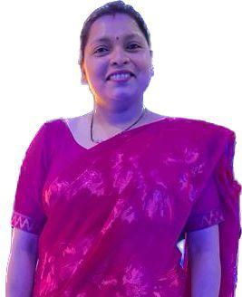
CHITRA JAIN
COUNCIL MEMBER, Anti-Domestic Abuse Council OF WICCI
An Modern Artist who narrated the boundaries of earth through arts and crafts work. In professional terms, created various exhibitions & set up outlets at malls, fair at Gurugram & Kota.
An vocalized, actively giving participation about the sexually abuse and woman harassment of society through various artistic tool & games to especially awaken woman of society and give awareness.
Mail - jainchitra.mcom@gmail.com

Slide 19
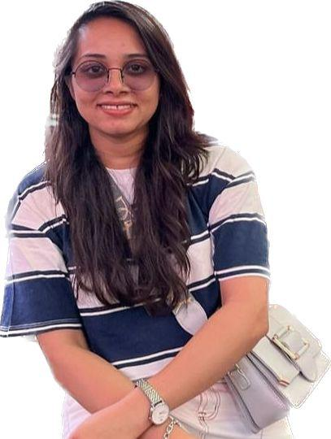
RIYA JAIN
COUNCIL MEMBER, Anti-Domestic Abuse Council OF WICCI
An feminist, cosmopolitan spreading awareness about Gender Equality supported by law at worldwide level and to stand for action against Domestic Abuse in Texas, USA.
Acquired strong educational background in Management and worked as a HR Head in India.
Associated with the Blind Eye Care Hospital, Guna which provide treatment of weaker eyesight and free medical aid to all the weaker and unprivileged section of society.
Email - riyajain8893@gmail.com

Slide 20
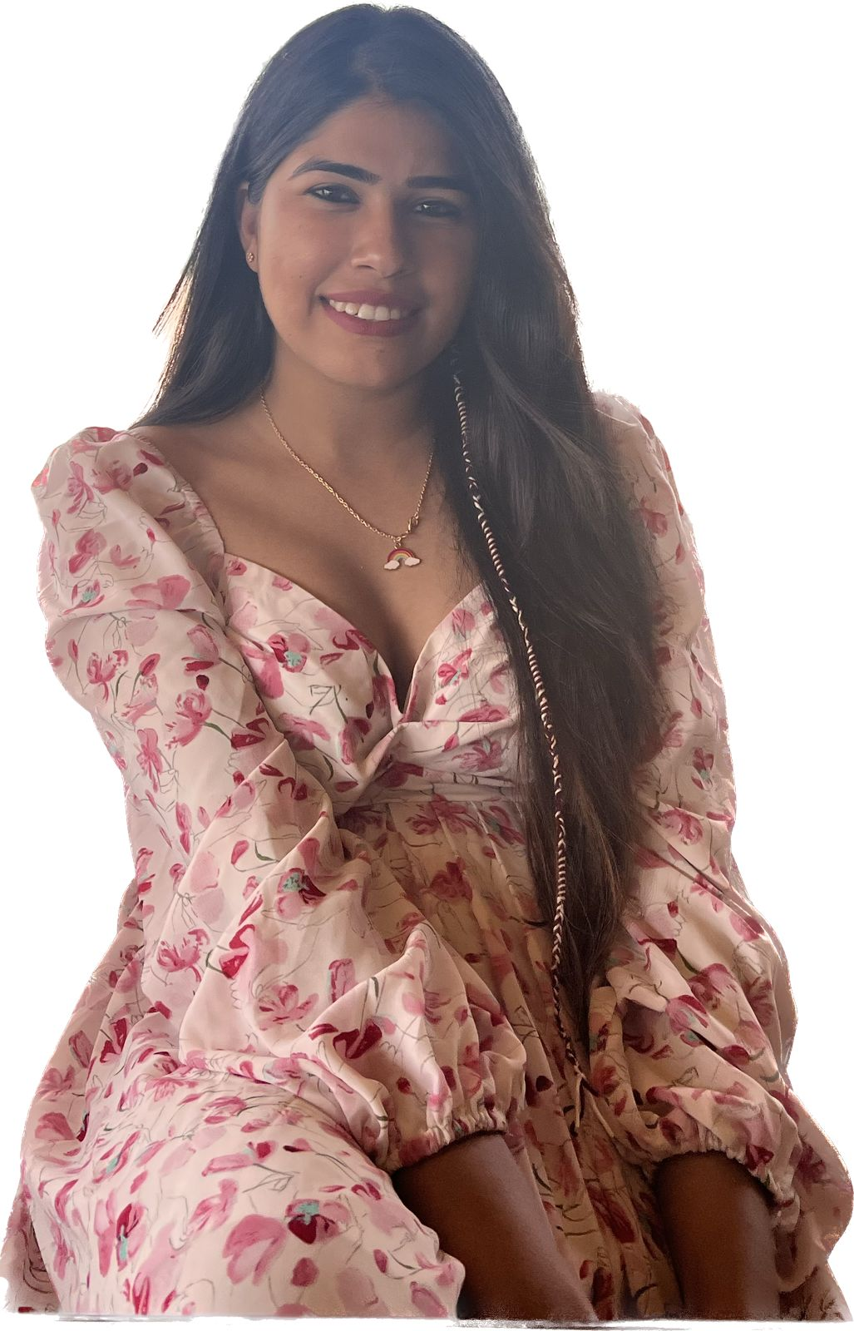
ADITI JAIN
COUNCIL MEMBER, Anti-Domestic Abuse Council OF WICCI
An Financial advisor & Stock Broker in share markets at a globally level from purchasing to selling of shares to an potential client.
Acquired with high morals and a very highly educated family background contribute into philanthropist who works for the upliftment of the society in the countryside by giving session and training for rights and duties.
Email – aditij54@gmail.com

Slide 21
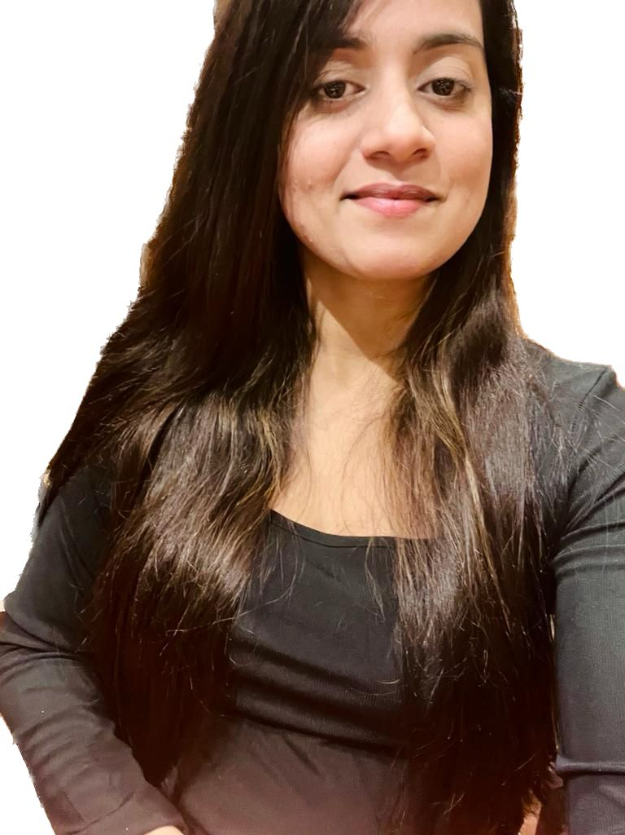
Dr. TAMANNA YADAV
COUNCIL MEMBER, Anti-Domestic Abuse Council OF WICCI
A medical practitioner practising in government hospital based at Gurugram.
Providing free medical aid & sanitization and making aware about intimate hygiene which is an indispensable part of woman to combat against the chronic diseases spreading such practices at the mass level to unaware woman of society.
Given Contribution for the betterment of the society at large.
Email - - tamannayadav2502@gmail.com

Slide 22
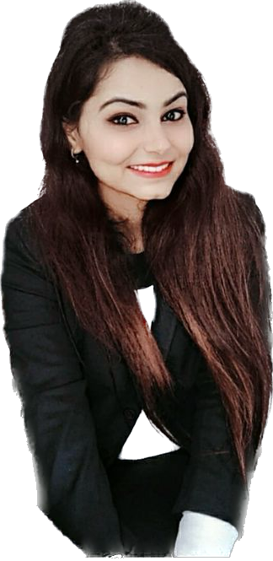
Adv. PARITA KAUSHIK
COUNCIL MEMBER, Anti-Domestic Abuse Council OF WICCI
Acquired B.A/ LLB (Hons.) from MDU University, Rohtak and MBA in HRM from Symbiosis University, Pune. After completing graduation, she has worked in District Courts Gurgaon. She handled various matters relating to Consumer courts, N.I Act (Cheque bounce matters), Labour & Employment matters, Divorce cases, Succession matters, etc. After completing her Post Graduation in HR, she started working and gaining experience in Human Resource Management in an IT Software Company, Gurgaon.
Email - advparitakaushik@gmail.com

Slide 23
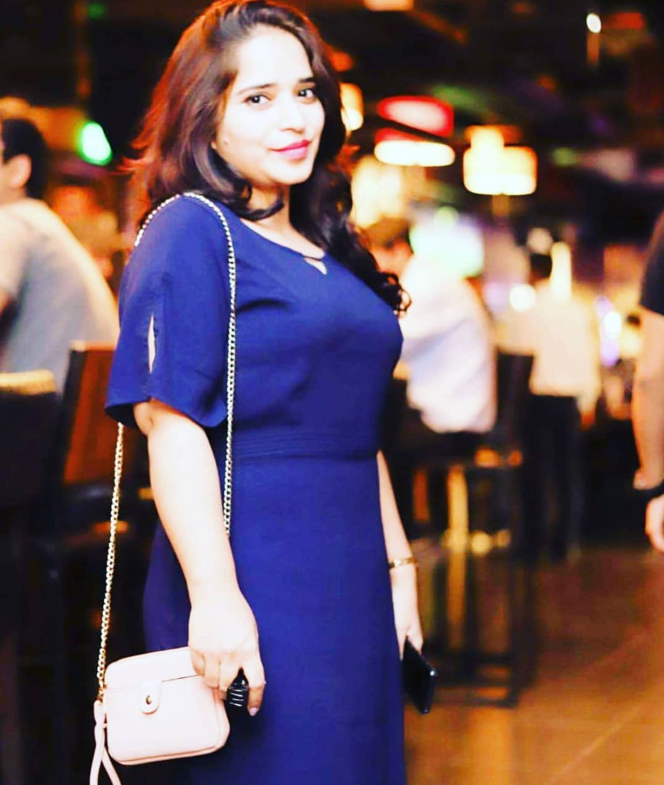
POOJA ARORA
COUNCIL MEMBER, Anti-Domestic Abuse Council OF WICCI
Currently working as a Educator in private school of English subject in Gurugram and in order to enhance academic skills specialised in MA English.
An homemaker cum independent woman provide free education to the unprivileged section of society through private tuition in aiming of upcoming generation will be shining star of country irrespective of poverty.
Email -

Slide 24
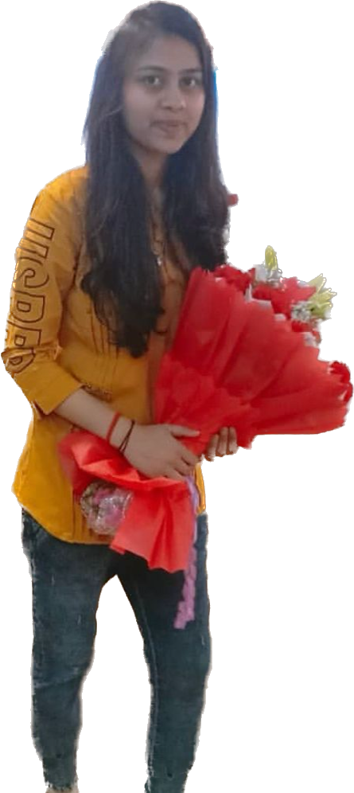
AARTI KAJLA
COUNCIL MEMBER, Anti-Domestic Abuse Council OF WICCI
An celebrity makeup artist at the most renewed saloon VLCC settled in Gurugram.
Providing free medical aid & sanitization and making aware about intimate hygiene which is an indispensable part of woman to combat against the chronic diseases spreading such practices at the mass level to unaware woman of society.
Email - aartikajla59@gmail.com

Slide 25
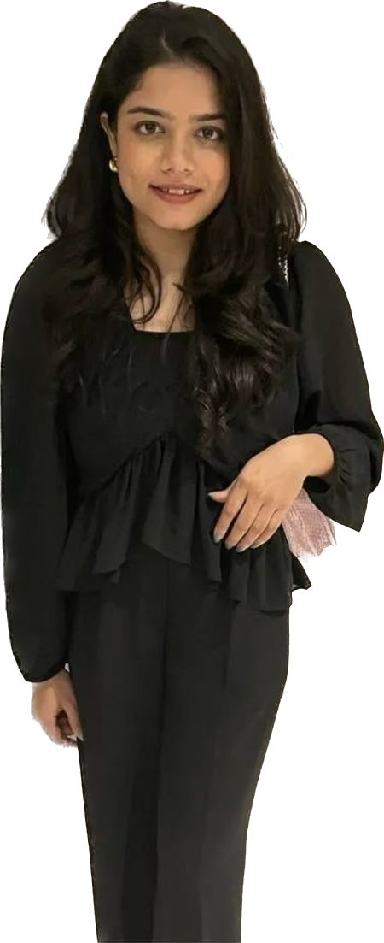
SADAGEE JAIN COUNCIL MEMBER, Anti-Domestic Abuse Council OF WICCI
Currently working as a technical recruiter at Sumeru Software Solutions in Indore (M.P). Corporate work includes screening and recommending prospective employees for a role. These roles cover a range of technical positions for entry level or mid level experience. Associated with the Blind Eye Care Hospital, Guna which provide treatment of weaker eyesight and free medical aid to all the weaker and unprivileged section of society.
Email - Sadgeejain20@gmail.com

Slide 26
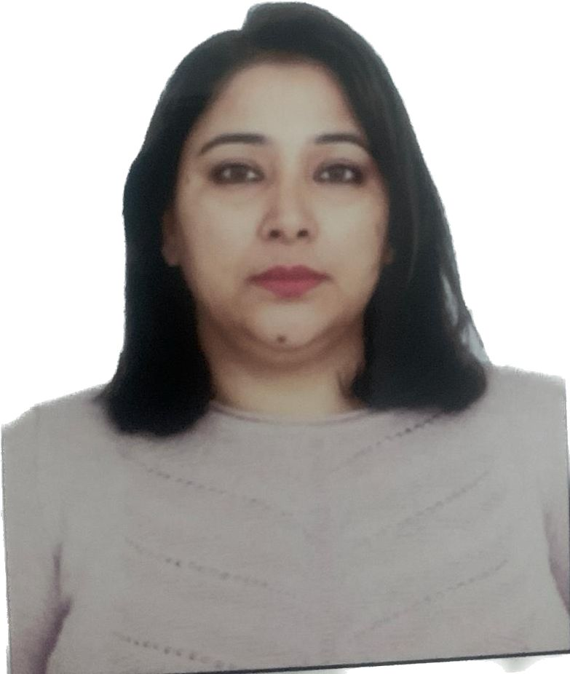
SANGEETA
COUNCIL MEMBER, Anti-Domestic Abuse Council OF WICCI
An Commerce graduate and gained Masters in Administration from the most promising university of India.
Currently, Human Resource Head in the Corporate Sector and gained years of experience in management department.
Email - sange12122015@gmail.com

Slide 27
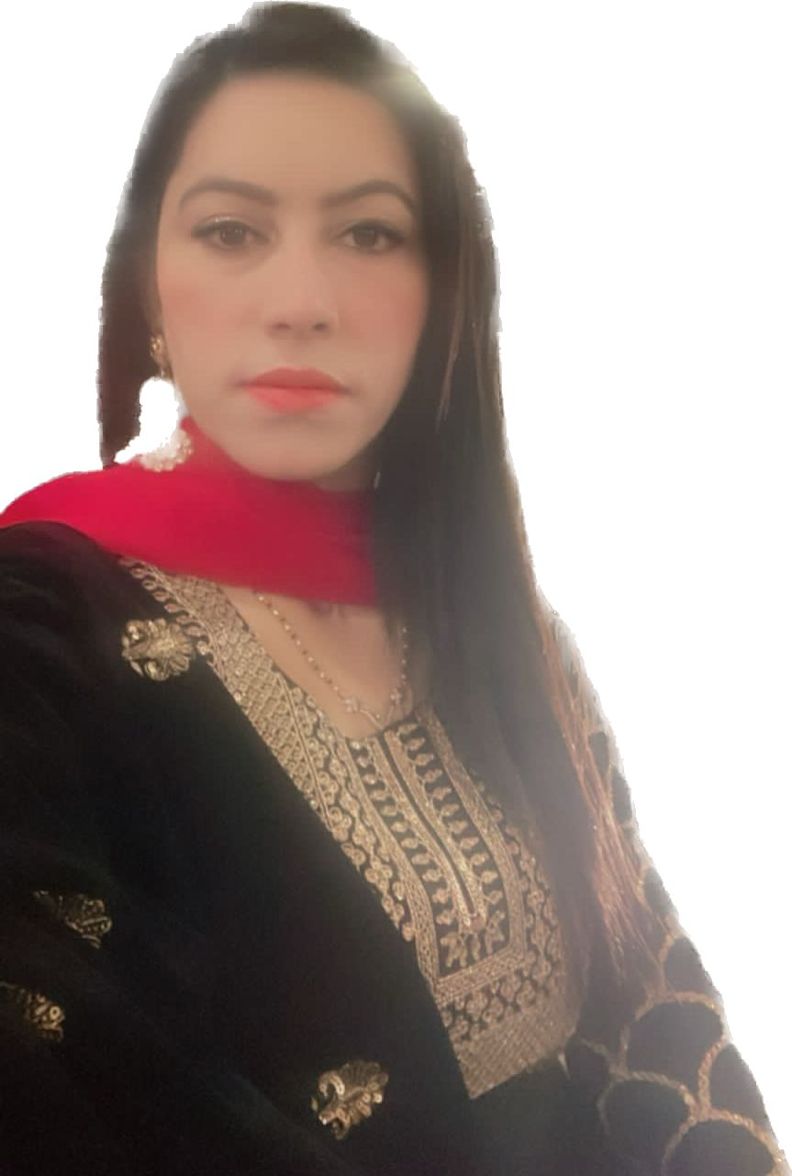
JYOTI SANGWAN
COUNCIL MEMBER, Anti-Domestic Abuse Council OF WICCI
Qualified Tutor, Lecturer in English and in addition to enhance knowledge and skills completed Executive MBA from IIMC.
Gained 8+ years of work experience in different corporate sector and currently working with Amazon India as Process and Communication Coach with QIT team.
An Homemaker cum independent woman and mother raising the bar at personal to professional life by not believing in not surrounded to Domestic Boundary.
Email - Jsangwanheer@gmail.com

Slide 28
SUPPORTED BY
WICCI is supported by the massive global networks of ALL Ladies League (ALL), Women Economic Forum (WEF), and SHEconomy.
ALL is a movement of ‘Sisters Beyond Borders.’
WEF is a platform for ‘Business Beyond Borders.’ SHEconomy is e-commerce for women worldwide in Goods & Services for ‘Commerce Beyond Borders’

Slide 29
COUNTRIES REPRESENTED
Albania, Angola, Armenia, Argentina, Australia, Azerbaijan, Bangladesh, Brazil, Burundi, Cameroon, Canada, Chad, China, Costa Rica, Croatia, Cyprus, Czech Republic, Colombia, Ecuador, Egypt, Ghana, Germany, Greece, Guatemala, Hong Kong, Hungary, India, Italy, Israel, Ireland, Japan, Kazakhstan, Kenya, Kyrgyzstan, Lesotho, Luxembourg, Malawi, Malaysia, Mexico, Moldova, Monaco, Montenegro, Morocco, Mozambique, Malta, Netherlands, Nigeria, Nepal, New Zealand, North Macedonia, Norway, Paraguay, Portugal, Peru, Puerto Rico, Philippines, Qatar, Romania, Russia, Rwanda, Serbia, Singapore, Slovenia, Spain, South Africa, South Korea, Suriname, Sweden, Switzerland, Syria, Tunisia, Turkey, Uganda, Ukraine, UK, Uruguay, Venezuela, Vietnam, Virgin Islands (US), UAE, USA, Uzbekistan, Zimbabwe.

Slide 30
WOMEN'S INDIAN CHAMBER OF COMMERCE ANDINDUSTRY

