Slide 1
PROJECTS & EVENT MANAGEMENT COUNCIL (Uttar Pradesh)
WOMEN´S INDIAN CHAMBER OF COMMERCE AND INDUSTRY
www.wicci.in

Slide 2
Council Vision &Mission
VISION:
Promoting competence throughout society to create an ecosystem in support for women empowerment.
MISSION:
Facilitate co-creation and leverage the diversity of our network into benefits for the profession, economy, society and environment.
Offer know-how, products and services to the benefit of individuals, projects and organizations across public, private and community sectors.
Maximize the synergy in our network to help all member associations develop according to their needs Promote the recognition of project management and engage stakeholders around the world in advancing the discipline

Slide 3
Welcoming
Council Members to
WICCI
President, Vice President
and 20+ Nominated Council Members

Slide 4
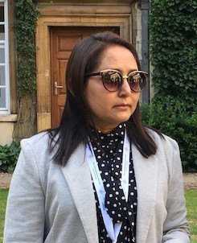
PROF. AYESHA FAROOQ
PRESIDENT, (Projects & Event Management) COUNCIL WICCI
Dr. Ayesha Farooq is Professor of Strategy at the Department of Business Administration, Aligarh Muslim University, Aligarh, India. She was awarded a fellowship under the Netherlands Fellowship Programme (NFP) in 2013 and visited Maastricht School of Management, The Netherlands. Dr. Farooq has presented papers at international and national conferences. Several times, she has attended conferences funded by GRCC, University of Cambridge, UK. Prof. Farooq has visited the UK, France, Switzerland, The Netherlands, Germany, Belgium, and Malaysia for academic events.
She has published research articles in SCOPUS indexed and ABDC journals. Dr. Farooq is a resource person to the Cadbury Centre, University of Birmingham (United Kingdom) and created video content for UOB on different aspects of Strategic Management and other management schools. She has conducted MDPs on Strategic Management at AIMA and workshops on leadership & TQM at the Department.

Slide 5
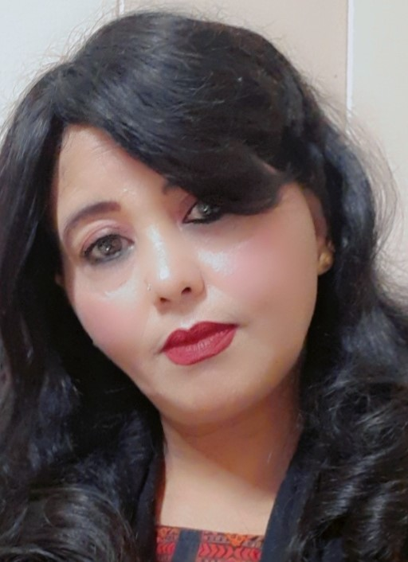
SAJIDA NADEEM
VICE PRESIDENT, (Projects & Event Management) COUNCIL WICCI
Sajida Nadeem is a committed and result oriented social worker associated with Dr. Zakir Hussain Foundation as Director, Women Empowerment Cell and General Secretary since 2004.
She is the Member of Advisory Committee, PCPNDT, Aligarh Commissionary, Aligarh Executive Member of School Management Committee of Ayesha Tarin Modern Public School, Aligarh.
She has been running Sewing Training Centre for women to make them self dependent, a ZHF Coaching & Guidance Centre for Poor students and a Charitable Ambulance Facility for poor patients in Aligarh District.
Ms. Sajida has maintained a network of women activists in Aligarh city to show solidarity in women’s issues – “female feticide”, “Women’s Safety”, “Women Empowerment” in interiors of Aligarh, UP”. She has made many charitable contributions with hospitals for poor patients in the form of providing medical aid and appliances and distributed bicycles and sewing machines to poor girl and widowed women in locals of Aligarh.

Slide 6
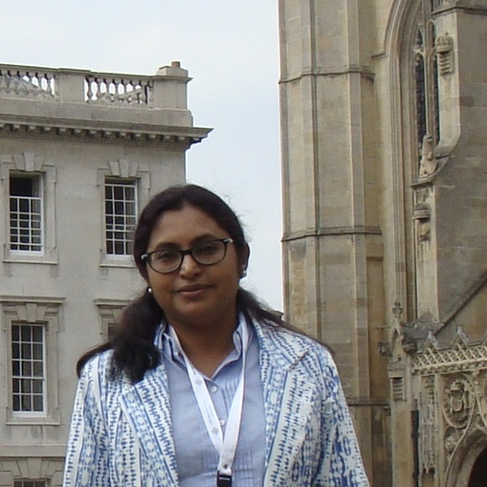
PROF. RAKSHANDA F. FAZLI
COUNCIL MEMBER, (Projects & Event Management) COUNCIL WICCI
Prof. Rakhshanda F Fazli has obtained her MA, M.phil. in Geography and Ph.D. in West Asian Studies(Geography) from Aligarh Muslim University. She has been awarded fellowship under the Netherlands Fellowship Programme (NFP) in 2008 to attend the International Institute for Geo-Information Science and Earth Observation, ITC, Enschede, the Netherlands and several times to attend short courses on Remote Sensing and GIS in IIRS, Dehradun, India. Her area of interest is Population, Resource development (Natural and Human Resources), Migration, Remote Sensing and GIS. She has published research articles in international and national journals of academic repute and chapters in books. She has been invited to present papers and deliver lectures at international and national conferences, workshops and courses. Prof. Fazli has visited UK (University of Cambridge & University of Oxford), France, The Netherlands, Germany and Belgium for academic purpose.

Slide 7
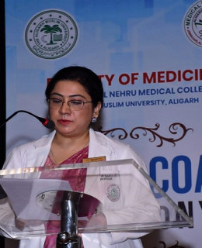
PROF. SAIRA MEHNAZ
COUNCIL MEMBER, (Projects & Event Management) COUNCIL WICCI
A well presented and articulate person who works in a thorough and committed manner 2. Quickly adapts to new systems and procedures 3. Able to use own initiative and work as part of a team 4. Conscientious and self-motivated 5.Proven leadership skills, including managing and motivating others to achieve objectives 6. An effective communicator at all levels within a department who works efficiently when under pressure..
Insert High Resolution Picture

Slide 8
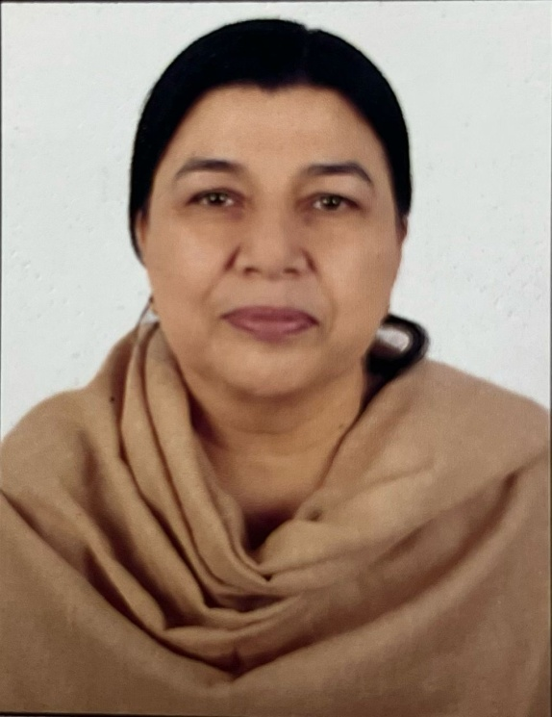
PARVEEN ALAM
COUNCIL MEMBER, (Projects & Event Management) COUNCIL WICCI
Mrs. Parveen Khan has been associated with child education and women welfare since 27 years through various non government organizations and Officers Spouses Club based in various cities of Madhya Pradesh. Presently I am associated with Ismat Literacy and Handicraft Centre since 2 years for education of underprivileged girls.
Insert High Resolution Picture

Slide 9
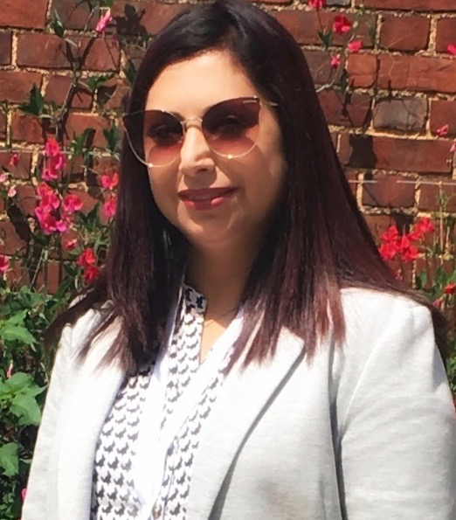
DR. SHAZIA FAROOQ FAZLI
COUNCIL MEMBER, (Projects & Event Management) COUNCIL WICCI
Dr. Shazia Farooq Fazli has obtained her Ph.D. in Sociology from Aligarh Muslim University, Aligarh, India. She has been awarded Post Doctoral Fellowship from ICSSR, New Delhi.She is presently working as Assistant Professor in the Department of Sociology.
She has also served as Assistant Professor in the Department of Sociology, Maulana Azad National Urdu University, Hyderabad.
Her areas of interest include reproductive health and reproductive rights of women and counselling to create regarding HIV/AIDS. she was associated with different NGOs, particularly Bill and Melinda gates Foundation and UDAAN Society Aligarh, working on women related issues. She has worked as a Research Associate in Project of "Migration, Poverty and Access to Health" funded by Indian Council of Medical Research. She has authored of a book entitled " Society , Culture and Reproductive Health".
Insert High Resolution Picture

Slide 10
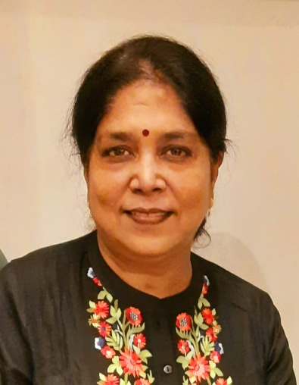
PROF. NEETA
COUNCIL MEMBER, (Projects & Event Management) COUNCIL WICCI
Professor / Head in the Department of English Shri Varshney College Aligarh. Has more than 30 years of teaching experience. Published Book, Research papers , Articles of general nature in reputed journals, magazines of national and international acclaim.
13 students have completed their PhD. thesis under her supervision. Her research areas are mainly contemporary issues like women empowerment, human relationships, environment etc.
She is associated with Dr. Zakir Hussain Foundation for last 10 years and actively participated in different activities organized by other NGOs like Universal education society, PFI, Bharat vikas parishad etc.
She has also been the member of District level PCPNDT Advisory Committee for 6 years, at present the member of District Human Organ transplantation Committee.
Insert High Resolution Picture

Slide 11
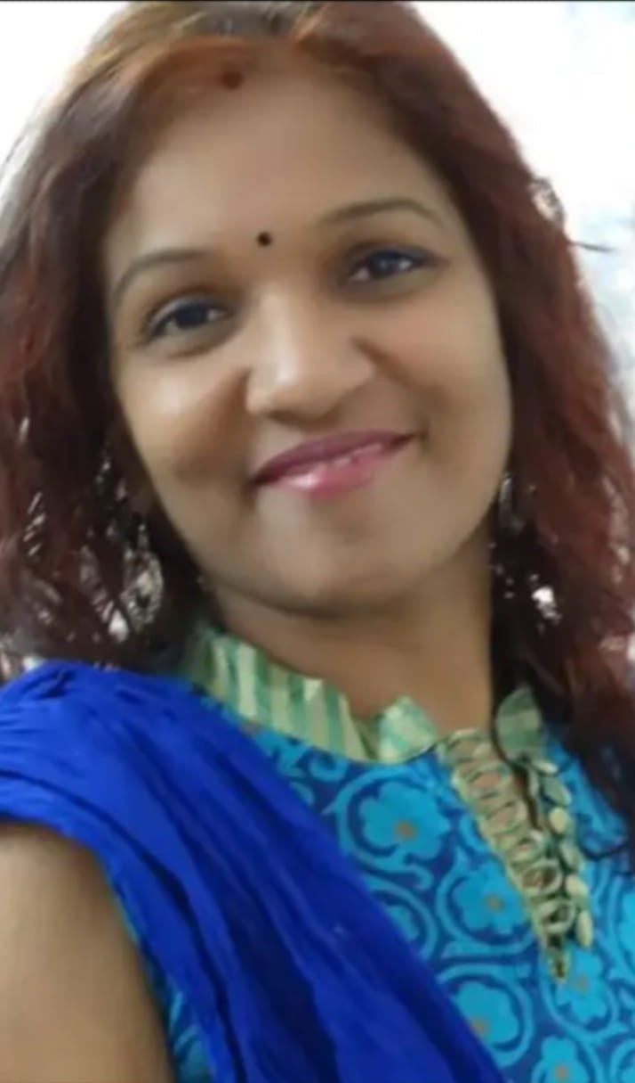
DR. SEEMA GARG
COUNCIL MEMBER, (Projects & Event Management) COUNCIL WICCI
Associate Professor
Ajay Kumar Garg Engineering College
Ghaziabad
B.Tech.(Electronics & Comm.)
MTech. (Automation & Robotics) PhD (Automation & Robotics)

Slide 12
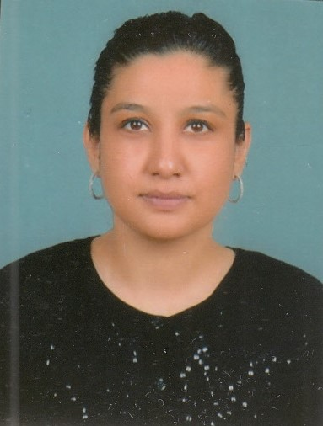
DR. ZAREEN HUSAIN FAROOQ
COUNCIL MEMBER, (Projects & Event Management) COUNCIL WICCI
Dr. Zareen Husain Farooq is an Assistant Professor at the Department of Business Administration, Faculty of Management Studies and Research. Her research and teaching activities mainly focus on Organizational Behavior, Change, Strategic Management, Leadership and Management and Islam. She concluded her doctoral thesis at the Department of Business Administration, Aligarh Muslim University. Her Ph.D. topic was 'Change Management through Balanced Scorecard Perspective: A Study of Selected Indian Organizations'. Zareen gained an M.B.A. and a First Class Honours for her B.A. in Economics at Aligarh Muslim University. She holds a certificate for attending Durham Islamic Finance Summer School at Durham University Business School, United Kingdom.

Slide 13
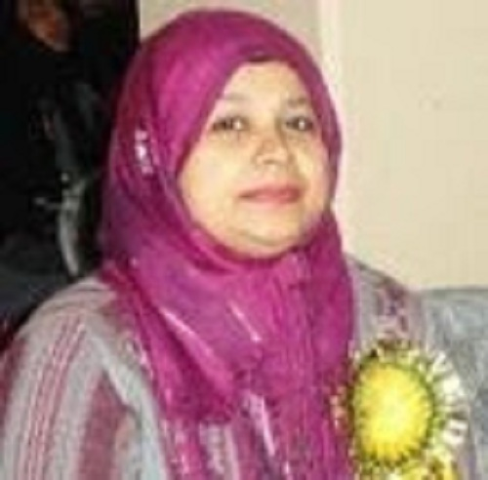
DR. SAMINA
COUNCIL MEMBER, (Projects & Event Management) COUNCIL WICCI
Dr. Samina, is presently working as Principal, AMU, ABK High School, Aligarh, India. She is holding Ph.D. in the field of Education along with a specialization in English. She has more than 16 years of teaching experience in the field of Higher Education and was associated with one of the most renowned institutes of Aligarh i.e. Al-Barkaat Institute of Education, Aligarh. She bears keen interest in Research, Educational Psychology and Social Service. She has contributed chapters in edited books in addition to publications in reputed journals. She has been convener to National Seminar sponsored by ICSSR, New Delhi, India and Course Coordinator to Refresher Program organized by CALEM, UGC, HRDC, AMU, Aligarh under the scheme of PMMMNMTT. She is the Adjunct Faculty for Research Guidance at Peeble Hills University, Indian Management Academy for Research Guidance since 2017. She has presented papers in more than 40 National and International Seminars, attended refresher courses including Academic Leadership participated in more than dozens of workshops and almost the same number of workshops are at her credit, which she had organized in local vicinity under the Project ‘Sharing the Knowledge’. She had been the recipient of many academic awards and scholarship and completed 15 days course on Test Construction from CITO International, Netherlands under the Netherlands Fellowship Program (NFP). She also visited Cambridge University for presenting a paper in Gulf Research Meeting, 2019, which is about to be published in a book.
Insert High Resolution Picture

Slide 14
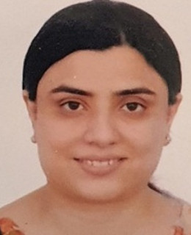
DR. IRAJ ALAM KHAN
COUNCIL MEMBER, (Projects & Event Management) COUNCIL WICCI
Dr Iraj Alam Khan passed MBBS in 2009 from Netaji Subhash Chandra Bose Medical College, Jabalpur and qualified MD (Pediatrics) in first attempt in 2012 from Gandhi Medical College , Bhopal. She worked as a Senior Registrar in Department of Pediatrics,Kalawati saran Children Hospital, New Delhi and JNMCH AMU Aligarh. After completing her tenure as Senior Resident, she joined as an Assistant Professor in the Department of Paediatrics, JNMCH, AMU, Aligarh, the post at which she is working since Sep 2015. The duties include teaching undergraduate and post-graduate students (MD & DCH), both clinical as well as classroom teachings; attending OPD, emergency calls, paediatric ICU and neonates, referrals from colleagues and allied specialties and helping post-graduate students with their thesis work. Currently, she is involved in developing Pediatric Neurology division in the department. This is to cater the ever increasing cases of epilepsy, neurodevelopmental delay and the other neurological issues of pediatric age group in our catchment area.

Slide 15
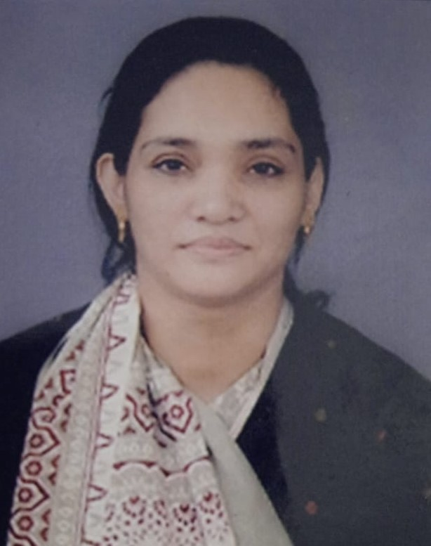
DR. TABASSUM SHAIKH
COUNCIL MEMBER, (Projects & Event Management) COUNCIL WICCI
In Teaching profession for the past 25 yeras.
Loreto Convent Intermediate College, Lucknow (10 years)
Cathedral Senior Secondary school, Hazratganj, Lucknow ( 11 years )
Middle East International school,RIYADH, KSA (1 year )
Online Teaching

Slide 16
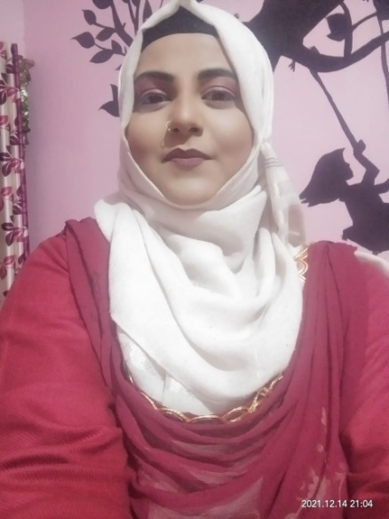
DR. SADAF RASOOL
COUNCIL MEMBER, (Projects & Event Management) COUNCIL WICCI
I m a Doctor n runs my own Hospital with name MAXO in Khurja, Dist. Bulandshahar. Being a doctor I usually arrange free health check-ups for ladies in my Hospital. Beside this I support and work for a NGO named Mahila Jeewan Utthan Samiti, which works to empower Women in our town by teaching them stitching n beautician course/Heena & Art etc..

Slide 17
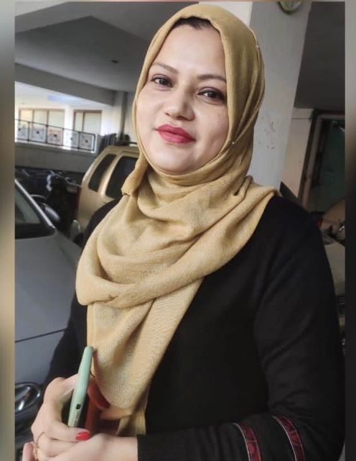
DR. SYYADA FAHEEM
COUNCIL MEMBER, (Projects & Event Management) COUNCIL WICCI
Dr. Syyada Faheem is Assistant Professor and the Coordinator of Applied Sciences and Humanities Section of University Boys Polytechnic. She has been teaching English and Communication Skills for over 17 years. She possesses a strong academic record, having University Gold Medals for standing first at the Graduate (BA(Hons)) and Post Graduate (MA) levels.
Her area of interest includes Feminist Criticism, Women's Studies, Continental Drama, Migrant Literature, Autobiographies and Memoirs. She has published papers in various Journals/Conferences of national and international repute.
Besides her academic excellence ,Ms Faheem is a painter , a traveler and a digital content creator.Also , she has been associated with various NGOs working for women empowerment.

Slide 18
SIMRAH FAZLI
COUNCIL MEMBER, (Projects & Event Management) COUNCIL WICCI
Pursuing B.Com (Final Year)
Aligarh Muslim University, Aligarh
Being an entrepreneur to help not only myself but to generate possibility for others and serving the humanity when there is crunch in the society.

Slide 19
MYSHA MANAAL TAJ
COUNCIL MEMBER, (Projects & Event Management) COUNCIL WICCI
Pursuing SSSC from DPS, Aligarh
I have contributed in organizing many competitions and functions at school.
I have assisted teachers and faculty with writing of certificates and registration forms.
I am a post holder in the student council and also the English editor.
Paper Contribution:
Paper contributed as Co- Author in GRM, 2022 in Virtual on the topic “Tourism, Economic diversification and Economic Diplomacy: lessons from the Arabian gulf.”
Got a Certificate of Appreciation for contributing my artwork inspired by women’s voice and vision at the “Women Depicting Women” Art Exhibition organized by Rising Beyond The Ceiling in June 2022
First prize in the inter-school poster making competition on the occasion of International Earth Day
7th rank in the school in international English Olympiad in Class VIII

Slide 20
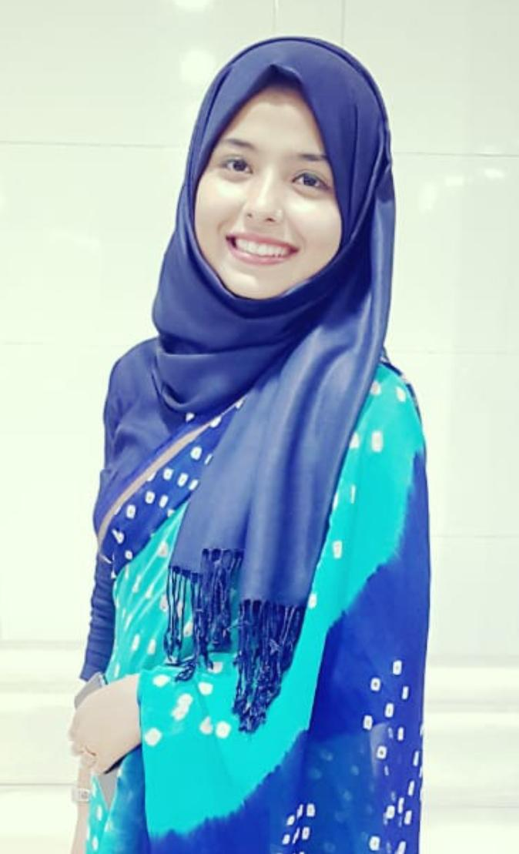
IRNA ISHRAT
COUNCIL MEMBER, (Projects & Event Management) COUNCIL WICCI
Research Scholar, Department of Business Administration, A.M.U., Aligarh
A driven management researcher who hopes to build a name for herself in academia by pursuing challenging and novel research interests. “I believe, my passion and hard work will enable me to contribute towards the academic interest of the University and social interest of the community”. Irna Ishrat is presently engaged in research projects internationally and pursuing research in the fields of social entrepreneurship and women entrepreneurship. She has worked professionally on government-approved projects before. She has been awarded with best paper presentations at two international conferences, and she even had her articles accepted for publication in reputable journals.

Slide 21
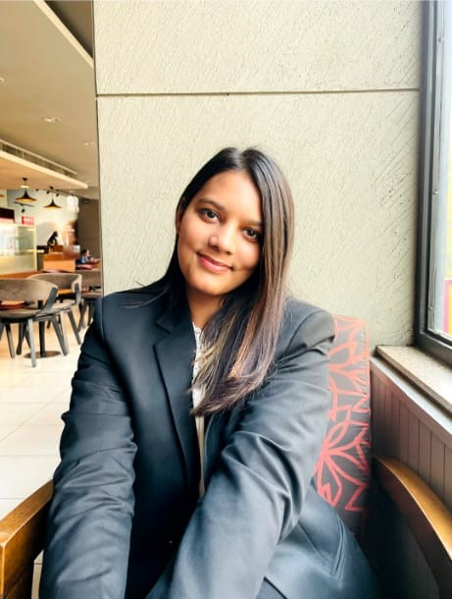
ALVINA RAIS KHAN
COUNCIL MEMBER, (Projects & Event Management) COUNCIL WICCI
I am a penultimate year law student at the Faculty of Law, Aligarh Muslim University.
Through my prior experiences, I have developed strong time management, writing, research, and analytical skills, which I am constantly refining. I have previously interned and worked across different verticals of law and other allied fields which include working with the team of India Today Group, Commercial Litigation and Arbitration (ASV Legal LLP, Chambers of Bharat Chugh and Indian Institute of Arbitration and Mediation), legal team of a public sector undertaking (ONGC) and several stints in human rights work as well (Human Rights Law Network, Zakir Hussain Foundation, People against rapes in India etc.)
I have always been inclined to work towards the growth of women and to provide them with a platform to voice their concerns.

Slide 22
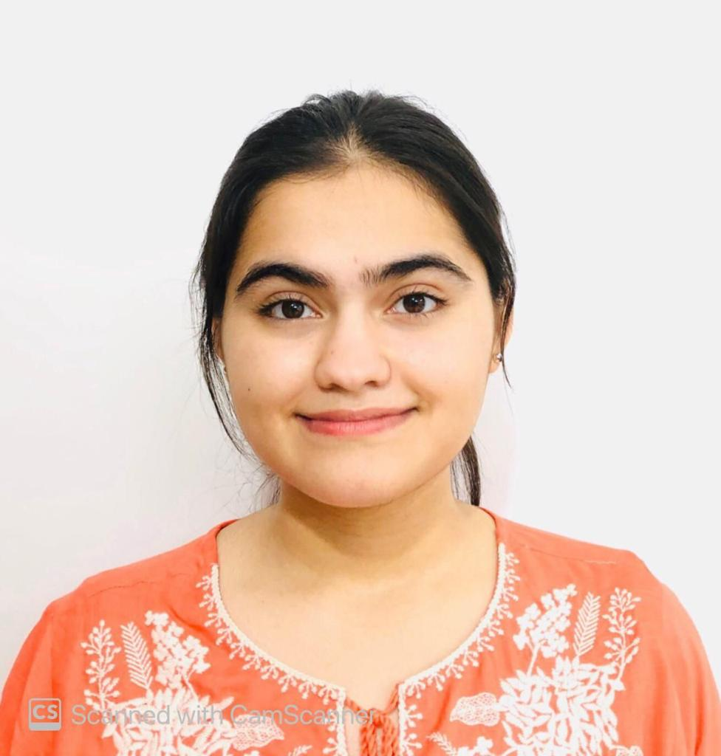
AYESHA TANVEER
COUNCIL MEMBER, (Projects & Event Management) COUNCIL WICCI
I am final year Commerce Department, Department of Law, Aligarh Muslim University, Aligarh.
A member of the University Debating & Literary Club (AMU).
Was a part of the PR team of AMU LitFest 6.0 which took place in May.
A member of the Women’s College Literary Society. The society conducts various types of competitions in Women’s College, AMU.
Active participant in speeches and debates.
Great speaking skills and leadership qualities. Amiable & cooperative.

Slide 23
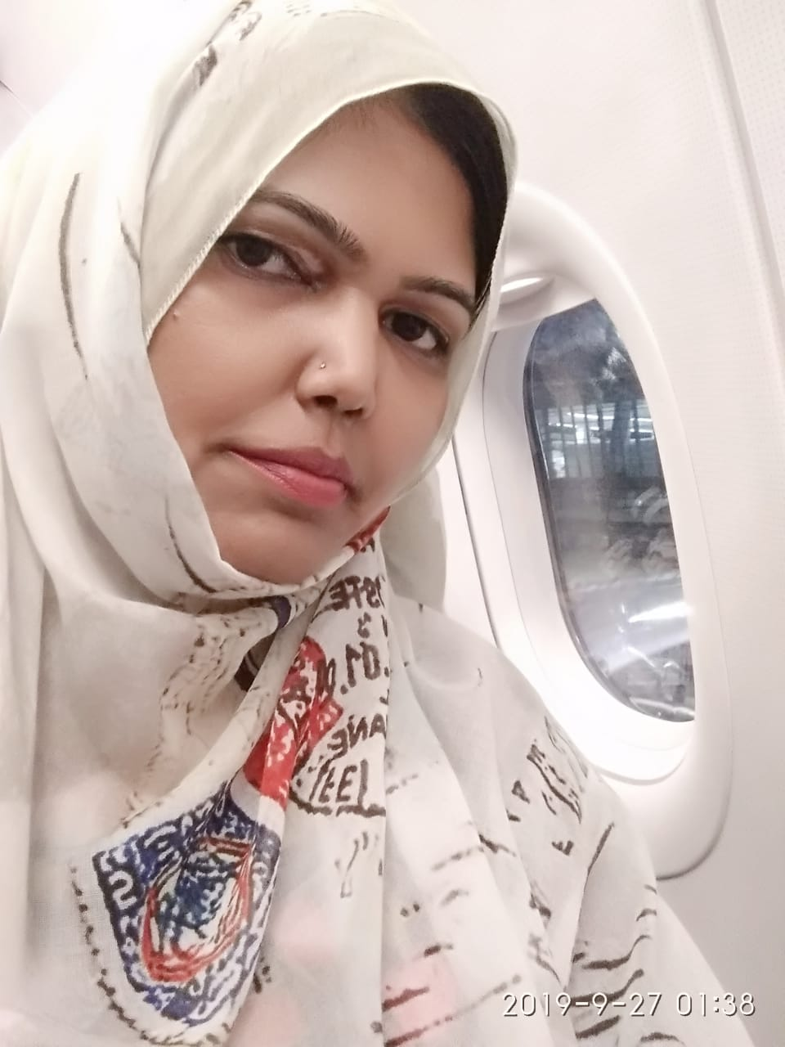
SADIYA USMAN
COUNCIL MEMBER, (Projects & Event Management) COUNCIL WICCI
I Sadiya Usman, ssociated with an NGO which provides free education to underprivileged girls from nursery to 10th standard. I started feeding camp for poor and needy people in September 2017 which continues till date. Everyday almost 250-300 people are fed at the camps organized by the society called Usmania Helping Hands Society ( a registered society ) the name it owe to my father Syed Usman Ali who always encouraged and supported me for this mission. Apart from feeding camps, our society provides blanket and warm clothes in winter season to the needy people. Free training center is being run by the society in which 6 months courses under a program skills development and provides computer course, fashion garments course and handicraft course, there are 58 students have been enrolled. Our society also organises free health camps at a regular interval of time. Blood donation camps also organized recently in collaboration with blood bank of Jawaharlal Nehru Medical College AMU, where hundreds of unit blood was donated. Our society received recognition for intense social work and for which I have received many honours and awards including International women Pride Award, Mother Teresa Humanitarian Award, Strong Women award, Women of Warrior award to name a few.

Slide 24
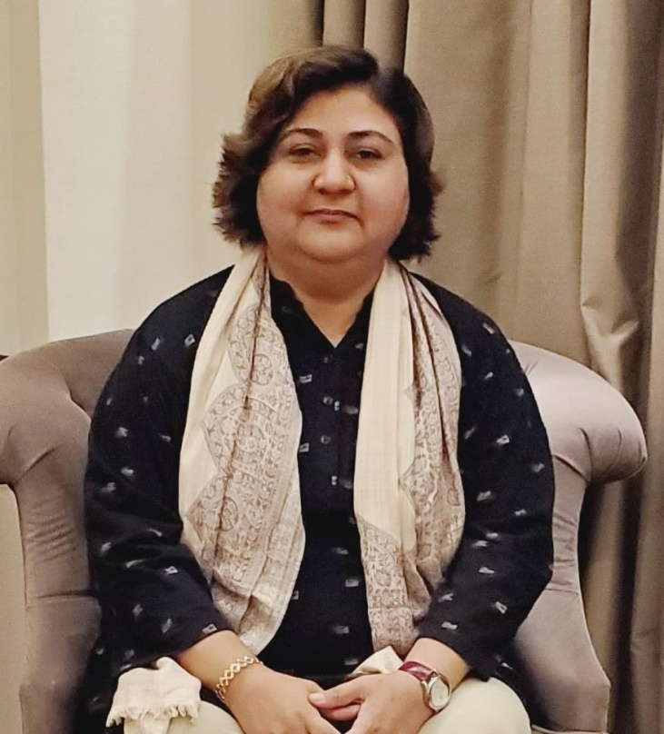
SOOFIA JAVED
COUNCIL MEMBER, (Projects & Event Management) COUNCIL WICCI
Mrs. Soofia Javed is a Distributor of Javed Gas Services, Aligarh and has made persistent efforts in serving society by working in various fields and extending support to those in need. She has also served as the President of National Industrial Training Institute, ATROLI in Aligarh, District Coordinator of Achievers Foundation and the National Vice President of Indian Educational Welfare Foundation. She is presently appointed as the Director of Women Empowerment Cell of Azad Foundation and she firmly believes in serving individuals, Society, Nation and Humanity with everything she got. She is a woman of sheer dedication and commitment.

Slide 25
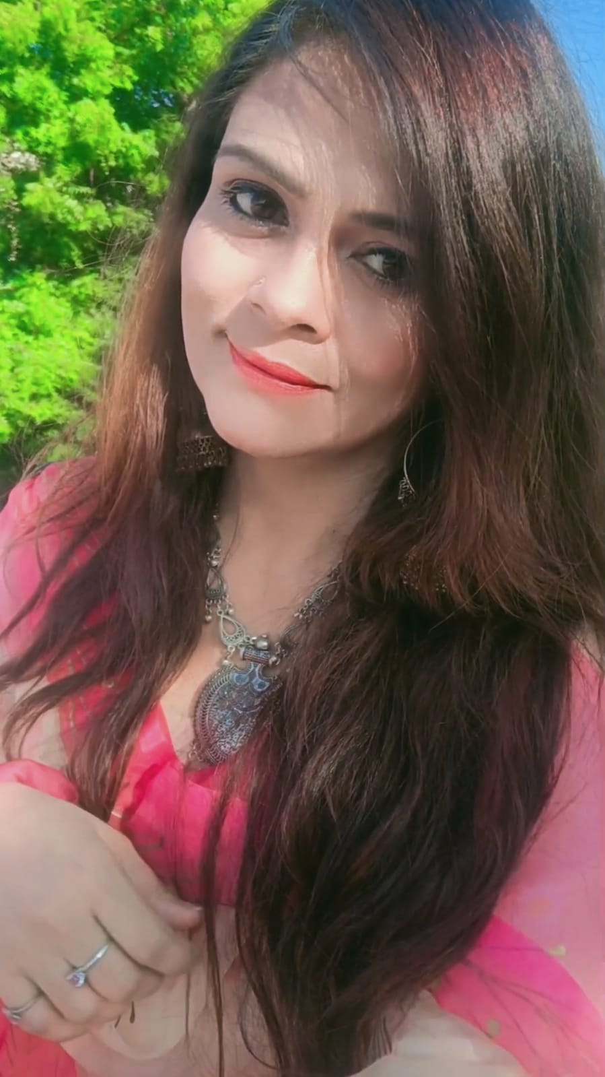
SHIRIN TABASSUM
COUNCIL MEMBER, (Projects & Event Management) COUNCIL WICCI
Mrs. Shirin Tabassum has been doing fabulous work in the society for people suffering from addiction and working relentlessly for social welfare and providing education for all. She has worked as a Counselor in “Nirvan De-addiction Centre” in Bareilly and has also been an active member of registered non-governmental organizations such as “Hum Safar Educational and Welfare Society” & Jeevan Dhara Rehabilitation Centre”. Additionally, she also runs a YouTube Channel and therein develops useful content.

Slide 26
SUPPORTED BY
WICCI is supported by the massive global networks of ALL Ladies League (ALL), Women Economic Forum (WEF), and SHEconomy.
ALL is a movement of ‘Sisters Beyond Borders.’
WEF is a platform for ‘Business Beyond Borders.’ SHEconomy is e-commerce for women worldwide in Goods & Services for ‘Commerce Beyond Borders’

Slide 27
COUNTRIES REPRESENTED
Albania, Angola, Armenia, Argentina, Australia, Azerbaijan, Bangladesh, Brazil, Burundi, Cameroon, Canada, Chad, China, Costa Rica, Croatia, Cyprus, Czech Republic, Colombia, Ecuador, Egypt, Ghana, Germany, Greece, Guatemala, Hong Kong, Hungary, India, Italy, Israel, Ireland, Japan, Kazakhstan, Kenya, Kyrgyzstan, Lesotho, Luxembourg, Malawi, Malaysia, Mexico, Moldova, Monaco, Montenegro, Morocco, Mozambique, Malta, Netherlands, Nigeria, Nepal, New Zealand, North Macedonia, Norway, Paraguay, Portugal, Peru, Puerto Rico, Philippines, Qatar, Romania, Russia, Rwanda, Serbia, Singapore, Slovenia, Spain, South Africa, South Korea, Suriname, Sweden, Switzerland, Syria, Tunisia, Turkey, Uganda, Ukraine, UK, Uruguay, Venezuela, Vietnam, Virgin Islands (US), UAE, USA, Uzbekistan, Zimbabwe.

Slide 28
WOMEN'S INDIAN CHAMBER OF COMMERCE ANDINDUSTRY

