Slide 1
ODISHA
WICCI-Anti-sexual harassment council

Slide 2
COUNCIL MEMBERS

Slide 3
Names & email ids of members
S.No | Name
1 | Promila Bagdi-President
2 | Sangya Sankshipta Das-Vice President
3 | Dr.Subhoda Banerjee-council member
4 | Srutisoumya Mishra-council member
5 | Myra Grace Simon-council member
6 | Rekha Lahon-council member
7 | Charu Katewa-council member
8 | Manodeepa Sahoo-council member
9 | Sonali Behuria-council member
10 | Prativa Patra-council member
11 | Manisha Rani Dash-council member
12 | Supreeti Patra-council member

Slide 4
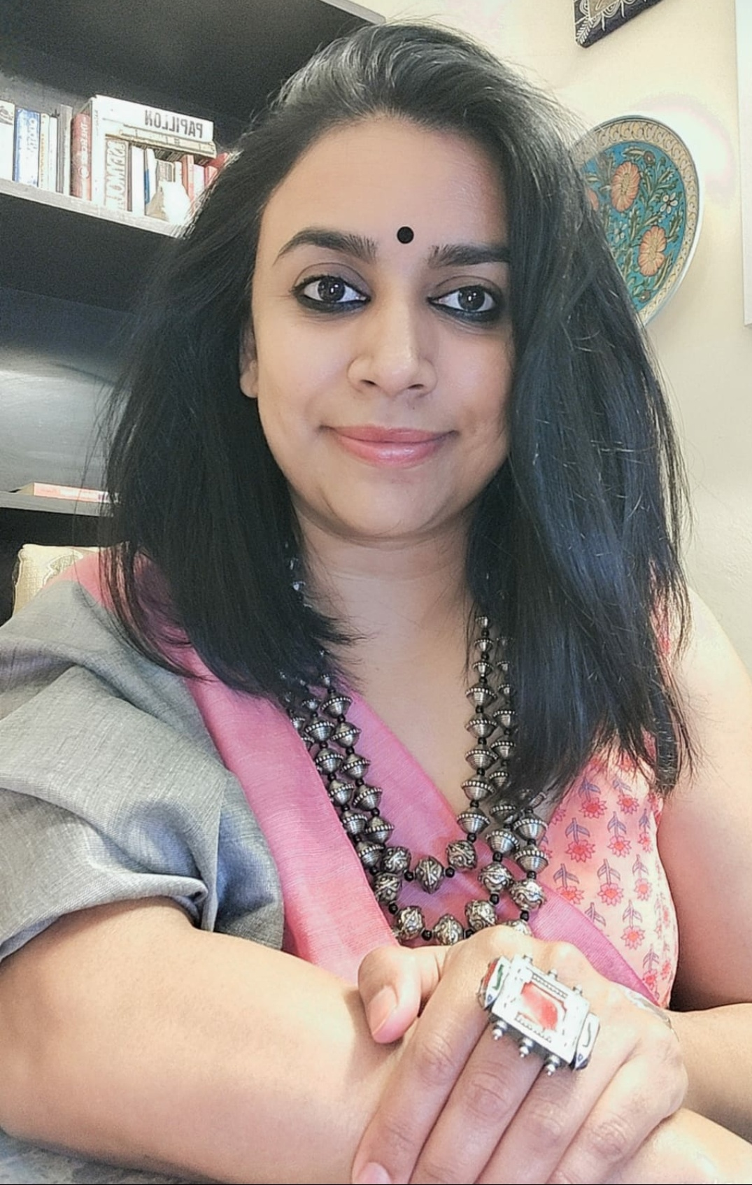
Promila Bagdi President
After celebrating 15 successful and rewarding yrs in IT Sales at leading Global IT giants, Promila is now founder of ZETOSH-Zero Tolerance for Sexual Harassment. Promila is certified on PoSH Act 2013 from Institute of Company Secretaries of India(ICSI) , New Delhi with an ‘A’ and Human Rights Diploma from Jamia Hamdard. Alongside she is double Post Graduate in Public Administration & Political Science and is a proud student of XLRI-Jamshedpur. She is now a full time PoSH external member, trainer, coach & speaker covering both organized and unorganized sector. Promila loves to travel with her 8-year-old son and explore new places within and outside India. She has been working for women, children and animal welfare and wants to do lot more for the society. Promila is passionate about bringing community together as one and work for the upliftment of the underprivileged across India.

Slide 5
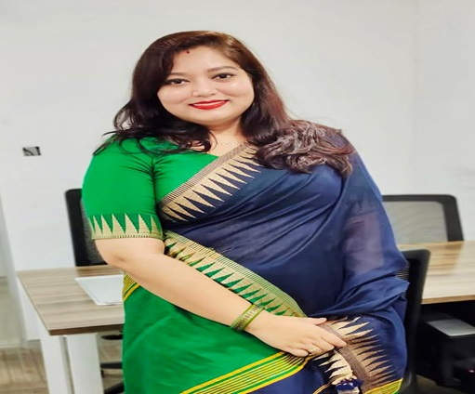
Sangya Sankshipta Das Vice-President
Sangya is an MBA grad from KIIT in Marketing and Finance. Education in KIIT enabled her to become aware of varied issues faced by women from across India as well as other parts of the world. She has a no-nonsense attitude towards certain issues especially on women rights, equality and safety. With total work experience of 8 years in IT/ ITeS specifically in Presales, she has worked in MNCs such as Tech Mahindra and Gemini Consulting and Services. She has had the opportunity of working with both Public/ Govt. as well as Private Sector Clients. Interaction with personnel from different verticals and industries also helped shape her outlook and world-weariness to a great extent. Currently she is the Lead of the Tendering Team at Gemini working as the Bid Manager. She has been awarded multiple times by the organization for her excellent performance. Sangya strongly believes in women power and unity.

Slide 6
Dr. Subhoda Banerjee Council Member
Dr. Subhoda Banerjee is presently working as an Assistant Professor in Law, at St. Xavier’s University kolkata. She holds a Ph.D. degree on the research topic “Whistleblowers Protection in India, Issues and Challenges - A comparative Analysis with reference to the Legal Systems of India, U.K. and South Africa” from The West Bengal National University of Juridical Sciences (WBNUJS), Kolkata. She has completed her LL.M. with specialization in Corporate Law and Governance from Chanakya National Law University (CNLU), Patna. She is also a certified Prevention of Sexual Harassment at Workplace (POSH) Professional and has obtained her certification from The Institute of Company Secretaries of India. Dr. Banerjee started her academic journey as an Assistant Professor (Law) at Ramaiah College of Law, Bangalore. She has also worked with Big4 consultancy firm Price Waterhouse Coopers(PwC) and reputed MNCs like Thomson Reuters and Wipro Technologies. Dr. Banerjee has published and presented several research papers at national and international level. She has also completed several Faculty Development Programmes. Dr. Banerjee is also associated with several organizations as a Subject matter Expert and a Faculty Advisor. She is passionate about working for the upliftment of women, children and animals.

Slide 7
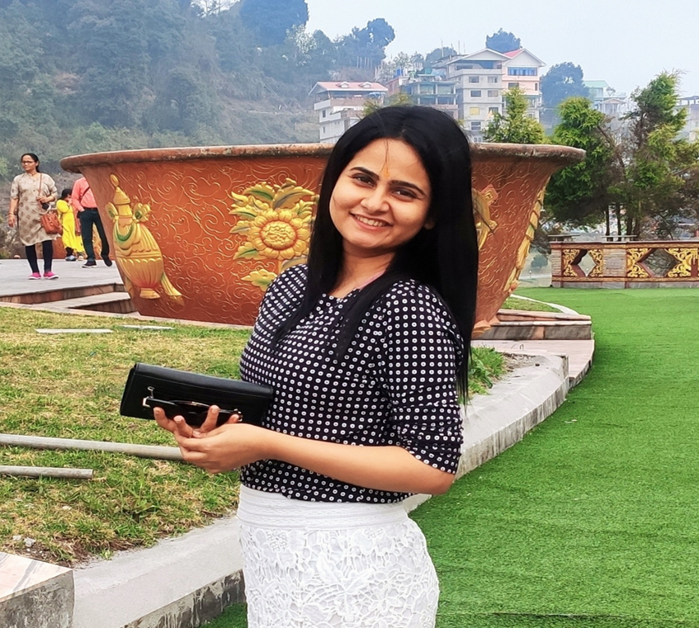
Srutisoumya Mishra Council Member
Sruti works as a senior software engineer in a leading IT firm in Bengaluru. She is a B.Tech from Gandhi Institute of technology and Management Bhubaneswar, with total 8 years of work experience. Sruti has never missed any opportunity to come forward and help women in need in all the way that she can support. Odisha Though currently in Bangalore but her home state is Odisha. With excellent process coordination and computer skills, she is keen to contribute, learn and grow being part of the Odisha Anti Sexual Harassment Council.

Slide 8
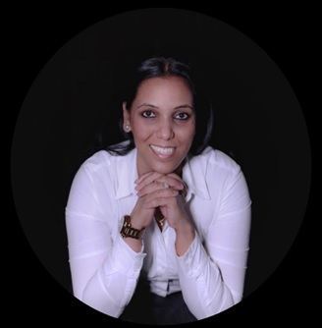
Myra Grace Simon Council Member
Myra has been driving the global business through digital transformation projects for nearly two decades. Grit and experience built digital solution capabilities and new age solution development while meeting rigorous cost and time constraints to create competitive edge in fast-changing market environment. An enthusiastic certified TOGAF 9 Enterprise Architect. An advocate for championing Women Leadership. She has exposure of Global Implementation of a digital platform that supports the products across BFSI, Retail, FMCG, Media and Entertainment and Travel and Tourism Industries. Trusted as a single point contact for Digital Transformation projects with organizations across United Kingdom, Canada, United States of America and APAC Region, Myra strongly believes when women come together as a community, not only women but the entire society grows at a tremendous pace.

Slide 9
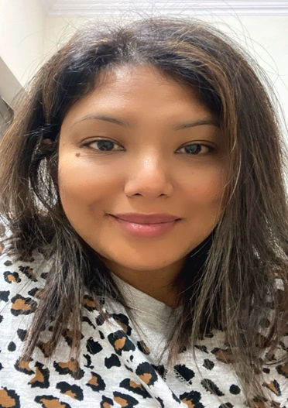
Rekha Lahon
Council Member
Rekha is a business Development professional and a management graduate. A Naturopath with an experience of two decades in Healthcare Platform in different branches like Administration, Clinical Practice in Rehabilitation Healthcare operations, Customer experience, MIS Reporting and Marketing Information System (MIS) with more of International Business experience in B2B , B2C , in the Africa , CIS , Asian Territories. She is very well versed with New Market Development and possesses sound knowledge of analytics, Communication and Interpersonal Relationship Building qualities which she has gained by extensive travelling across the Globe and by interacting with the Healthcare professionals as well as the Healthcare Policy makers. Another area where she is keen on contributing is arranging Training, learning Exchange programs for the needful Healthcare professional in various Countries. Rekha has had a fabulous working experience with women in her career and is a firm believer of together a community we can overcome all the challenges. She is passionate about creating a strong Healthcare sustainable Business centers and providing services to the needy people.

Slide 10
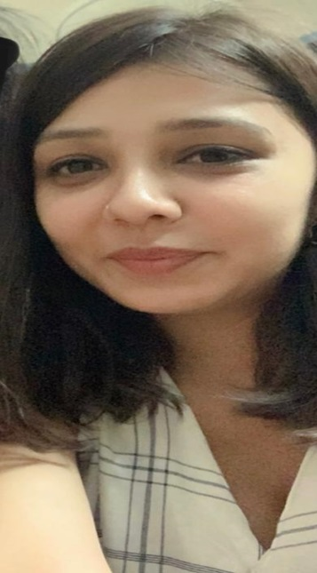
Charu Katewa Council Member
Charu is a senior HR professional with more than 7 years of experience in the Finance Industry, carrying a unique blend of expertise in handling Business Operations and Human Resources Management. She has handled diverse HR roles involving Talent Management, Employee Engagement, and Talent Acquisition and is currently the Assistance Manager - HR at SK Finance Limited. A strong advocate of gender equality and women’s rights, she aims to work towards creating workplaces characterized by diversity, equity, and inclusion. Charu is a happy student of XLRI-Jamshedpur.

Slide 11
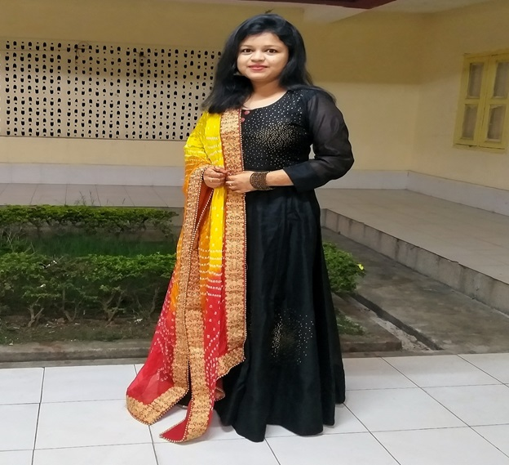
Manodeepa Sahoo Council Member
Manodeepa is currently working as SAP MM consultant at Gemini consulting & service from past 2 years, after completing her SAP course from Bangalore. She has completed her MBA from Utkal University and is interested in learning and contributing towards mental health and women empowerment. She wants to contribute in all the way possible, for a better cause, to make the world a little more beautiful and peaceful place to live in. She strongly condemns all forms of violence, inequality & injustice against women.

Slide 12
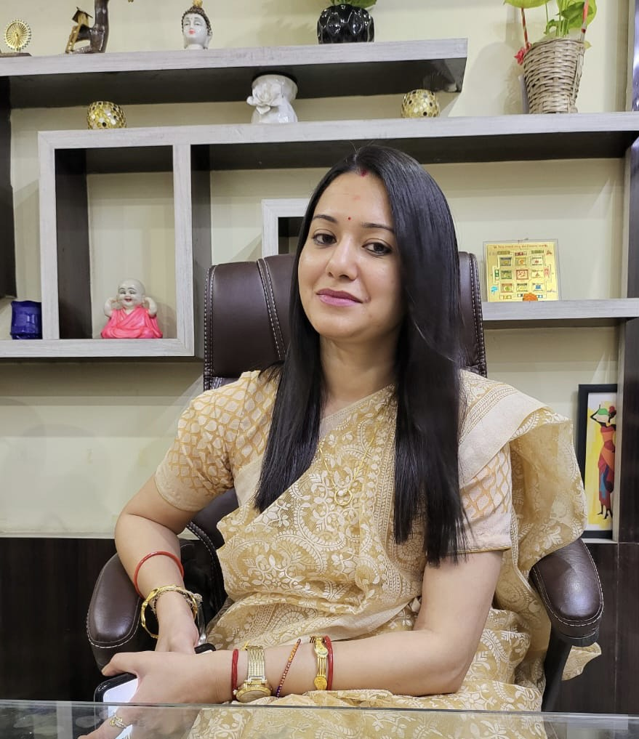
Sonali Behuria Council Member
Sonali is an MBA grad from KIIT School of management in Marketing and Finance. She did her undergraduate program in Business Administration from KIIT in 2015 with distinction. Alongside She is also passionate about dancing and is a good classical and semi-classical dance performer in Odisha state. She is committed towards working for women, children and culture of Odisha. . In total she has 7 years of successful work experience in leading Banking organization and National Distribution house, for private sector such as. Bajaj Capital Ltd, YES Bank Ltd,JANA Small Finance Limited. Sonali is currently working with ICICI Bank Ltd as a Deputy Branch Manager in Bhubaneswar, Odisha. Sonali loves to travel and is committed towards charity work and children welfare.

Slide 13
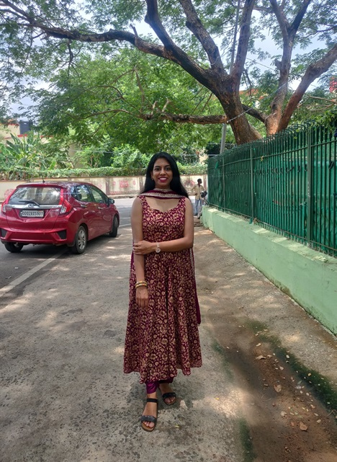
Prativa Patra Council Member
After earning her degree in MBA-Finance from KIIT University, she joined the corporate world starting with a big 4 consulting firm. In her 8 years of work experience as a finance professional in multiple leading consultancy firms, she has learnt that developing a strong relationship is the foundation of everything we do, both professionally and personally. Prativa has also volunteered in government schools to provide mentorship to students which helped her to find new ways to create opportunities for a better world and the feeling is very fulfilling.

Slide 14
Manisha Rani Dash Council Member
Manisha is a B-Tech graduate from BPUT and a trained Odissi dancer. She has also participated and won the Mrs. India contests many a times. Having been vocal about gender equality and women empowerment from a young age, she has witnessed women issues very closely and has never shied away from coming forward to help all. Currently working in Gemini Consulting and Services as Presales Executive, however have had the experience of working at PwC and other corporates. She is a firm believer of serving the society with good work.

Slide 15
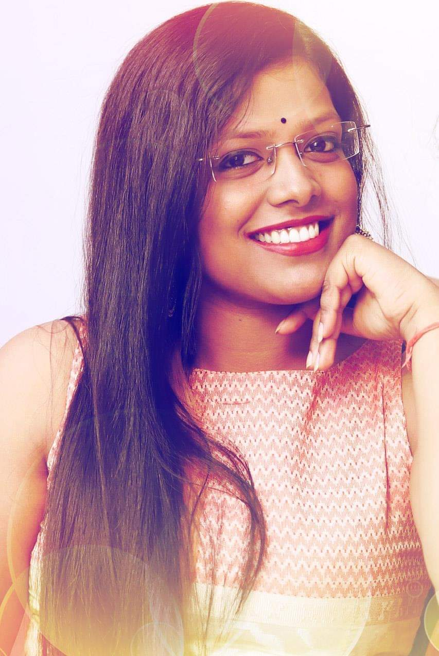
Supreeti Patra Council Member
Supreeti Patra is currently an entrepreneur-running a start-up.She is an MBA from a reputed institute in Odisha, with 5 years of work experience. She has worked with India's biggest farmer cooperative GCMMF Ltd. And also has research experience with the Bills and Melinda gates foundation. Volunteered with several non-profit organizations for child education and safety, gender and sanitation projects and several other government projects.

Slide 16
Proposed POA
To Organize seminars/workshops/awareness sessions in schools on PoSH Act 2013, as the latest judgement has clarified that the school girls are also covered in PoSH Act 2013.
To arrange conferences on Anti sexual harassment policy with the leading working women both from govt and private sector and spread the awareness in the state.
To raise funds in the state and plan events at various locations to spread awareness on how women can combat sexual harassment at work place and be empowered.
To have regular Odisha Anti sexual harassment council meetings offline /online
To build strong WICCI network and grow in Odisha.

